Slide 1
DroneX
Visual Drone Detection System
Youssef Barsoom - Computer Engineer
Nicholas King - Electrical Engineer
Harrison Kennedy - Electrical Engineer
Stephan Saturne - Electrical Engineer

Slide 2
Motivation
What is a Drone Incursion?
Drone incursions are any occurrence of a drone near an aircraft at anypoint in the flight.
The FAA receives over 100 reports per month of drone sightings, from pilots, citizens, and law enforcement. A number that has dramatically increased over the last two years.
The possibility of people using drones for mal-intentions is growing by the day as the use of drones also grows.
As of today there is no solid system in place at airports, sporting events, or schools where they can safely detect a drone and deal with the problem before bad things happen.

Slide 3
Motivation
We want to engineer a system that visually sees drones in the area and can immediately alert the users of the system.
We will accomplish this by using machine learning to decipher between other objects that our cameras might pick up on such as birds, planes, helicopters, etc.
Once the system decides that it is looking at a drone, it will alert our system.
When the users are notified of the drone in the area they can take necessary steps to remove the drone from the area.

Slide 4
Goals and Objectives
Provide a safe and effective solution to drone incursion detection at secure locations.
The system will be affordable in its final iteration although initial development of the product proved to be expensive.
The system will be low maintenance.
The system will be water resistant, withstanding the outside environment.
The system will run with the use of a DC power source
The camera will record a live feed of incursions

Slide 5
Goals and Objectives
When a drone is detected our system will notify the network and begin sending the live video to the server.
The Wifi module is used to send the video feed, due to destruction of the Cellular module
This server will record the video and upload to the website along with an alert of a drone in the area.

Slide 6
Goals and Objectives
After a drone is detected and the drone is lost or out of range, the system will record for 10 more seconds and will then shut off.
The DroneX website will be a user-friendly interface that will raise alerts when drones are detected.
The website will also show all previous drone incursions, the date and time of incursion, as well as the duration of the incursion.

Slide 7
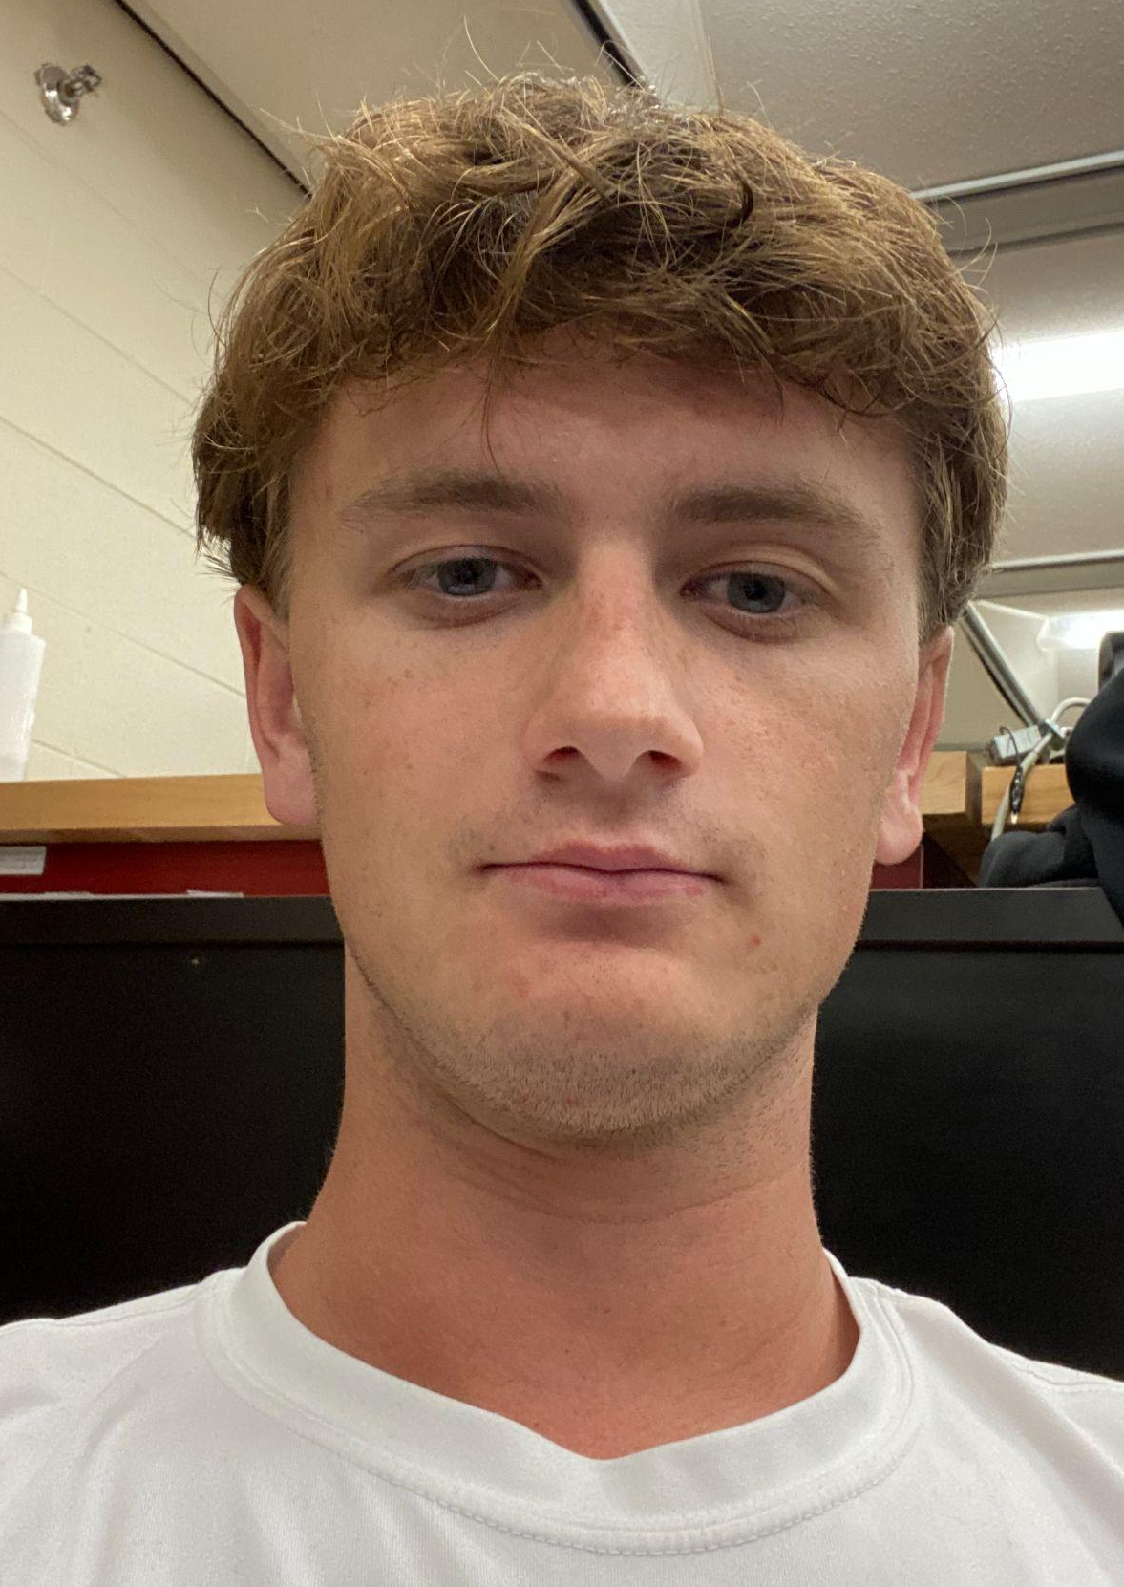
Specifications
Engineering Requirement | Specification
Drone visibility percentage | >20%
The Jetson Nano will receive the required input voltage to function | 6.3≥INVolt≥5
Recording will start | After first detected frame
When a drone is in frame it will be detected in | <30 milliseconds
The case must be within the parameters LxWxH | 29x20x15
The latency of the live video | <90 seconds

Slide 8
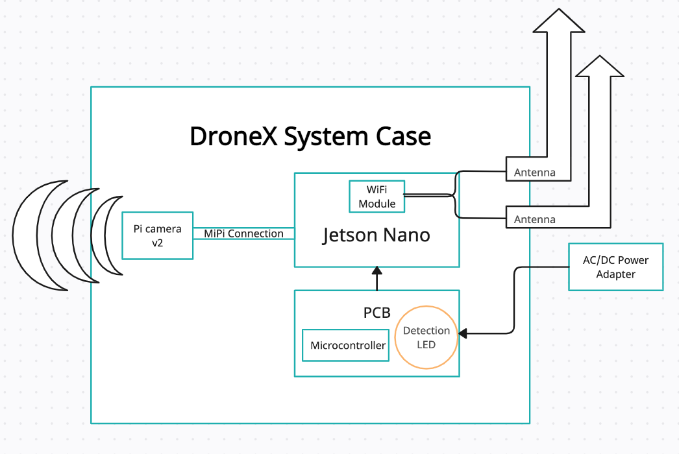
Hardware Block Diagram
AC/DC Power Adapter
PCB (Power System)
Jetson Nano Module by NVIDIA
Wireless Module
Pi Camera
Antennas
PCB

Slide 9
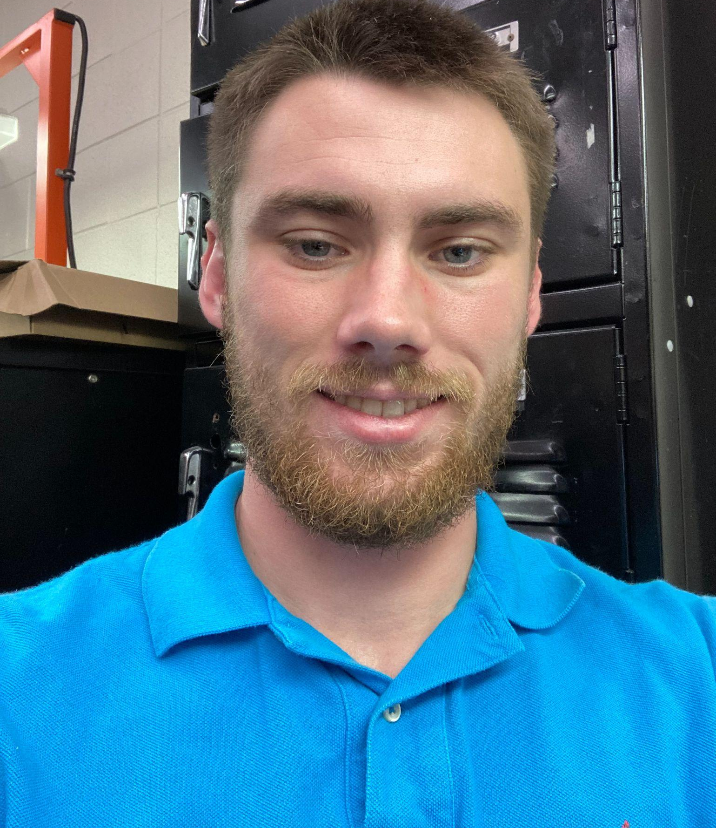
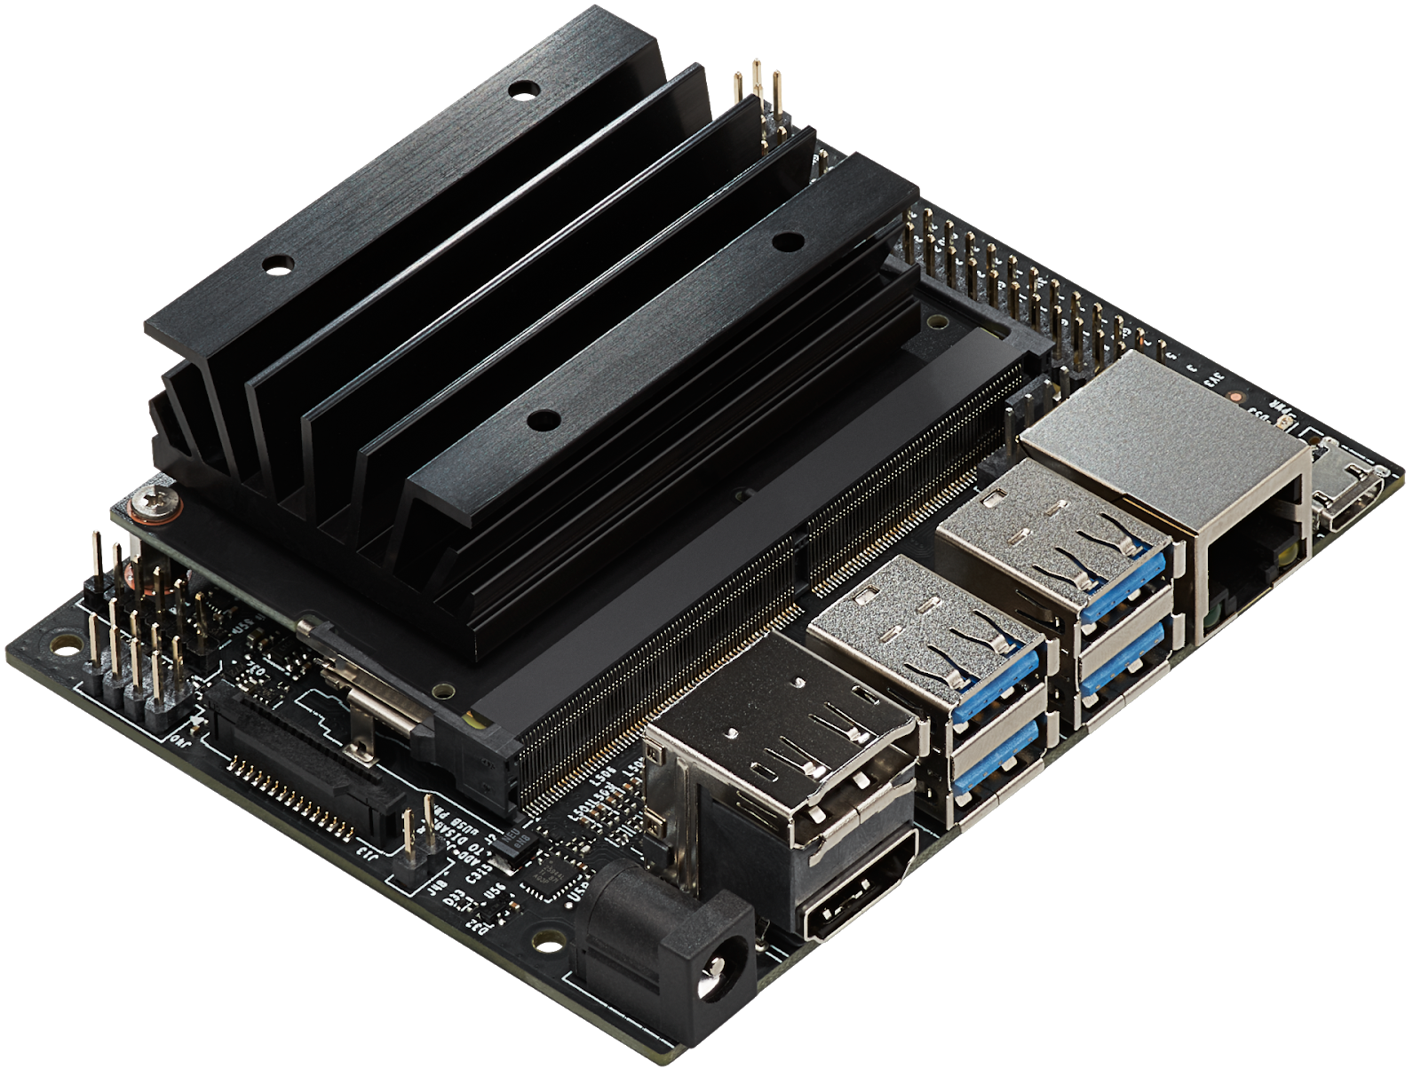
Machine Learning assistant device
Device | Coral Dev Board | Jetson Nano Development Board
Memory | 4 GB LPDDR4. | 4 GB LPDDR4.
Cost | 129.99 | 149.99
Supported Neural Networks | TensorFlow lite | Jetpak SDK
Resources | Limited online resources | Many online resources
Misc | 24 pin header single MIPI connection | 40 pin header double MIPI connection
Notes:
Required a device that can run multiple machine learning algorithms at the same time. Ideally with a lower power threshold. Also needed to have the capability to have 2 cameras connected to the device.

Slide 10
Visible spectrum camera
Camera Model | e-cam30_CUNANO | Pi camera V2
Resolution | 3.4 MegaPixels | 8 MegaPixels
Time to integrate into system | Integration took 2-3 days | Integration took 2 hours
Cost | $159 | $30

Slide 11
Communication Module
Model | Waveshare AC8625 Wireless Module | EC25
Communication type | Wifi | Cellular
Upload speed | Upwards of 100Mbps | 50mbps
Cost | $20 | $60
Accessibility | Can be placed directly on jetson | Requires a microcontroller to send data adding complexity
Notes:
The cellular module we chose

Slide 12
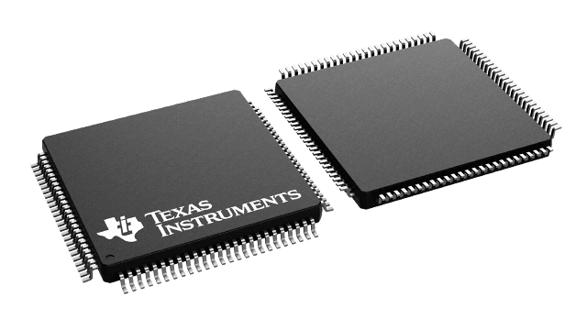
MCU Selection
We originally chose the MSP430FR6989 module for our board
It was chosen due to its flexibility having multiple UART I2C and I/O pins for us to use as well as a dev boards already purchased which made prototyping easier.
The microcontroller original supplied a UART connection between the Jetson and the Cellular Module but due to the breaking of the cell module the Msp430FR6989 lost its functionality in our project.

Slide 13
PCB DC input schematic
This component allows for a male DC jack to be inserted into our system to power our system. The diode was replaced with a zero ohm resistor to test input voltage and current but the capacitors are maintained to ensure voltage is stable within the system.

Slide 14
Power Regulators
We originally designed 3 voltage regulators: 3.3V, 3.8V, 5V,
Notes:
Using the Webench development tool we selected the 3 voltage regulating circuits to implement into our design. The 3.3 volt regulator is going to power our microcontroller the 3.8 V will power our cellular module and the 5 V will power the jetson nano. Which in turn also powers the 2 cameras we are using.

Slide 15
Power Consumption
Power Consumption was a metric of interest for our project as we explored the possibility of powering the system using a solar battery combination. Upon further research with an average cost battery and solar panel we could only maintain operation for 1.5 hours. This was because the Jetson Nano required a constant power of over 10 watts. Thus we changed our focus to a wall outlet operated system.
Notes:
The Jetson nano will be the highest cost component when compared to the other components on the board

Slide 16
Overall PCB Schematic

Slide 17
PCB Layout
Keep design simple
2 layers
Notes:
PCB board is 84.76 mm* 134.6 mm

Slide 18
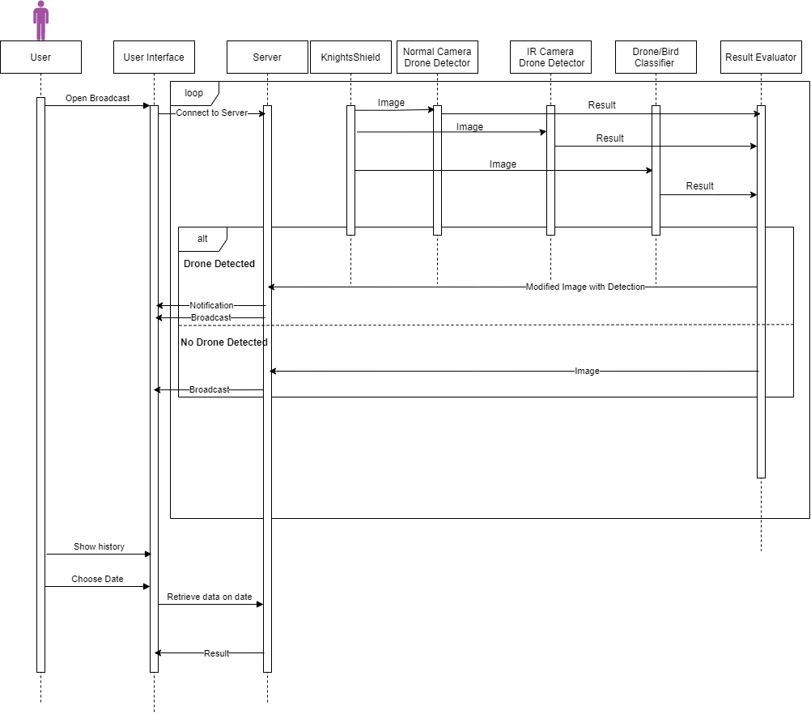
Sequence Diagram
Youssef

Slide 20
Overview of System
Website
Responsible for displaying live stream from the Jetson Nano
Show previous recordings captured by the Drone Detection System and necessary information about recording.
Developed using Next.js
Server
Responsible for converting RTSP to HLS
Uses NGNIX to stream
Managing the data in the database
Ubuntu 20.2
Database: MongoDB
Storage: Google Drive
Drone Detection System
Deploy on Jetson nano
Developed using Python 3
Consist of 3 Main Modules:
Drone Detection
Streaming Module
Recording Module

Slide 21
Drone Detection System
Drone Detection:
Uses the model that we trained to try and detect drone in each frame
Streaming Module:
Stream the output of the drone detection in a RTSP Stream which converted by the server to HLS to be able to stream in on a website
Recording Module:
Records and manages the recording of the stream.
The module start recording only when a drone is detect then every 10 second we check whether there is a drone. If yes, we continue else we stop recording and add to database
For a recording to be saved, drone visibility rate has to be higher than 20%

Slide 22
Object Detection
YoloV5 is used for good accuracy and fast detection
The Training dataset that is used consists of 3 public dataset which .
Drone Dataset (50K+ images)
Flying Object Dataset( drones, helicopter, airplane and birds) (80K+ images)
Finally Landscapes High-Quality (17K+ images)
The dataset was divided into 81% training and 19% validation.
The latest model took 96 hours to train, 28 GB GPU and 60 GB RAM

Slide 23
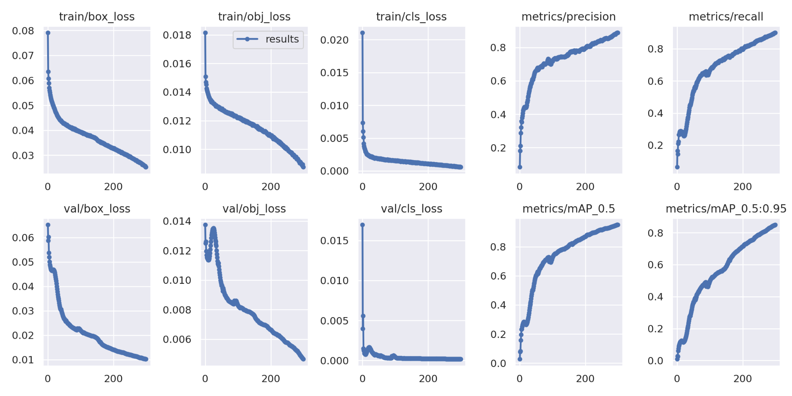

Slide 24
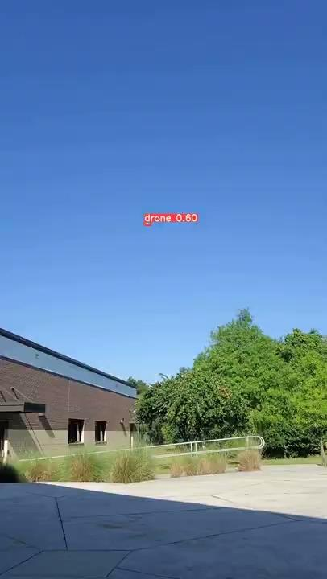
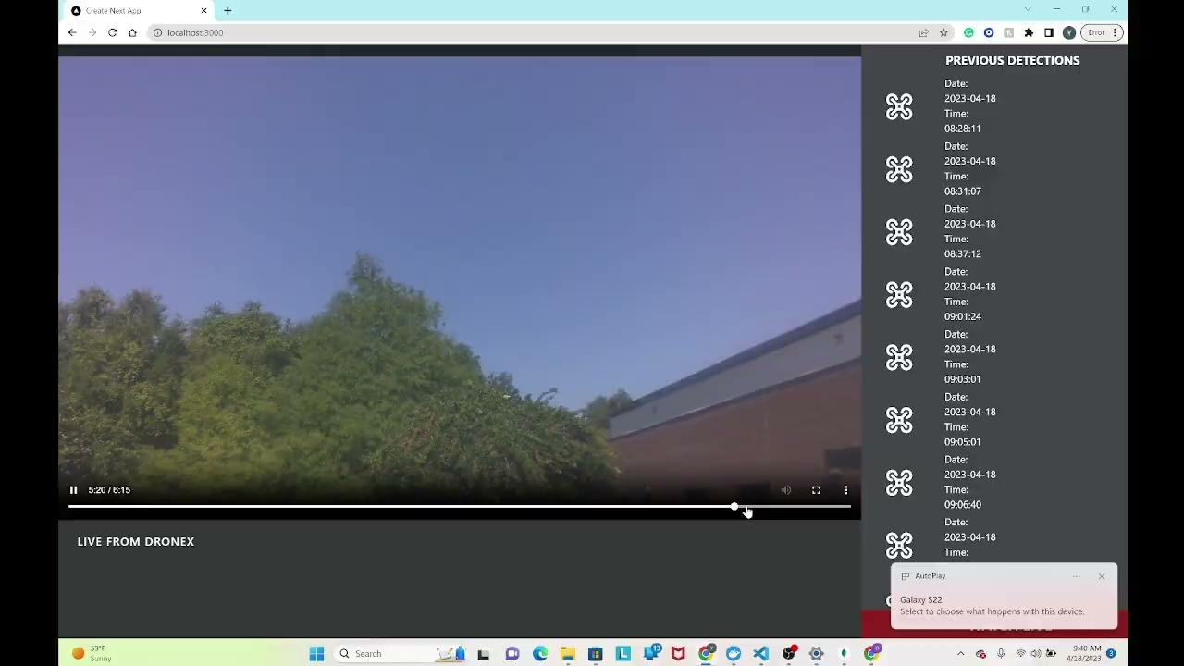
Model Comparison
1 Dataset(50K+)
12MP
3 Dataset(150K+)
3MP
3 Dataset(150+)
12MP

Slide 25
Software Frontend Framework
Framework | Language | Features | Cost
React.js | Javascript | Robust,Good for single-page,Components | Free
Angular | TypeScript | 2 way Data Binding | Free
Vue.js | Javascript | Simplicity and flexibility | Free
jQuery | JavaScript | Utilized in building desktop-based JavaScript apps,Simplifies dynamic content | Free

Slide 26
Web Stack
Youssef
Stacks | Tools
MERN | MongoDB, Express.js, React, and Node.js.
MEAN | MongoDB, Express.js, Angular, and Node.js.
LAMP | Linux, Apache, MySQL, and PHP.

Slide 27
Streaming Protocols
Youssef
Protocol | Pros | Cons
HLS(HTTP Live Streamng) | Ultra-high-quality video streams, secure, compatible with any internet-enabled device | Cannot maintain low latency, Poor Ingest
Secure Reliable Transport (SRT) | Very secure, compatible with any internet-enabled device, low latency | Limited Support
Real-Time Messaging Protocol (RTMP) | Low Latency, adaptive , and integratable in different video formats | Low Bandwidth
WebRTC | Real-Time Latency, Flexible | Limited Support

Slide 28
Storage
Youssef
Name | Pixel size | File size for one hour of video
720p | 1280 x 720 | 800 – 900MB
1080p | 1920 x 1080 | 1.2-1.4GB

Slide 29
Computer Vision
Youssef
Models | COCO mAP | Speed (ms) | Outputs
Faster R-CNN ResNet50 V1 640x640 | 29.3 | 53 | Boxes
SSD MobileNet v2 320x32 | 19 | 20.2 | Boxes
EfficientDet D0 512x512 | 39 | 33.6 | Boxes
CenterNet MobileNetV2 FPN 512x512 | 23.4 | 6 | Boxes

Slide 30
Further Improvement on current model
Youssef
Re-train on more images including images of images in long distance and near camera.
Try different models to figure best performing model

Slide 31
Housing our system
The system case must hold:
PCB
Jetson Nano module
Camera
Port for the antenna connection & power cord
Our housing case MUST be water resistant.
The case needs to have a transparent opening or wall for the camera to see clearly out of.

Slide 32
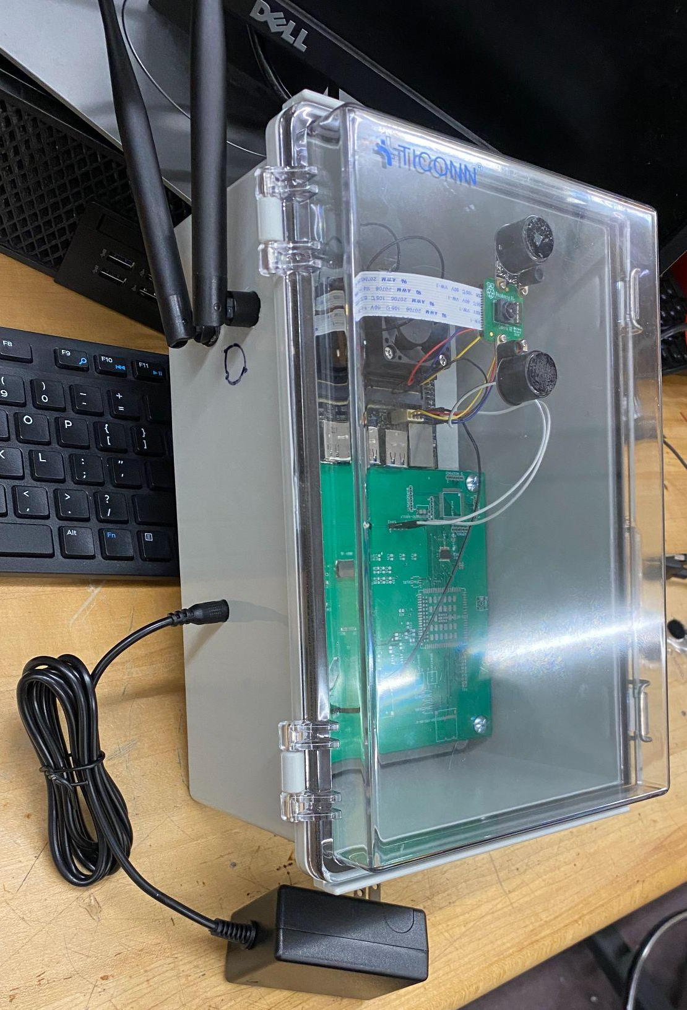
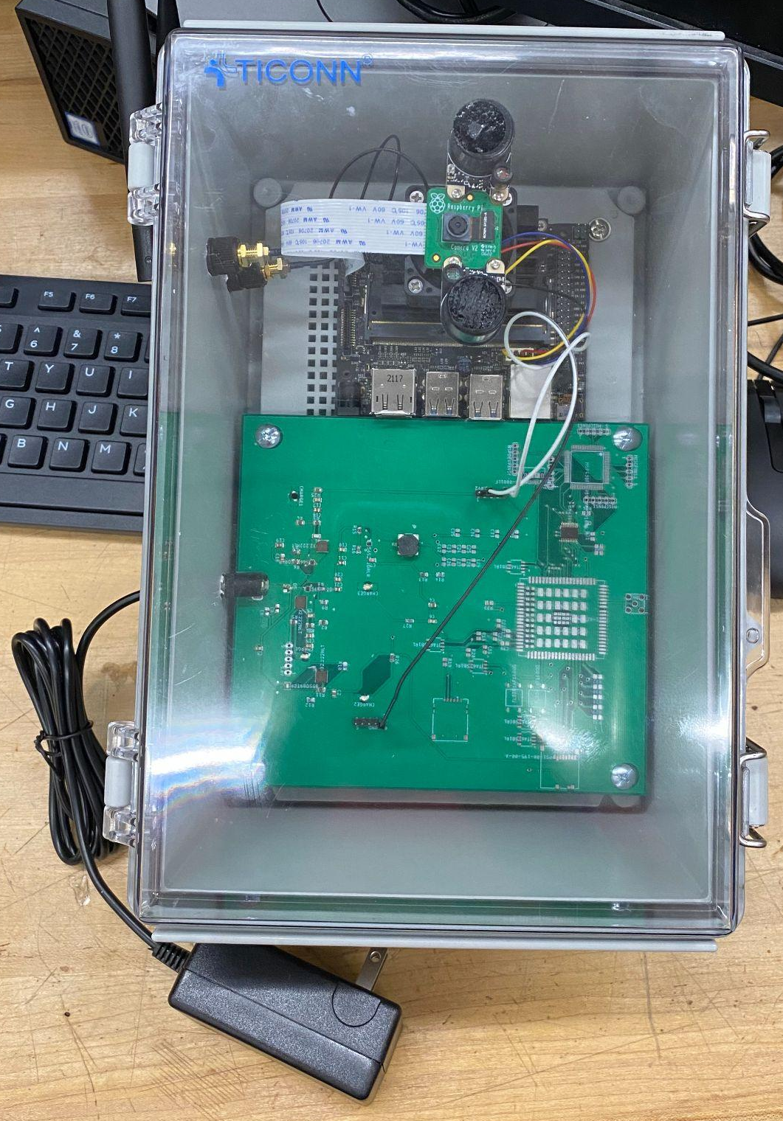
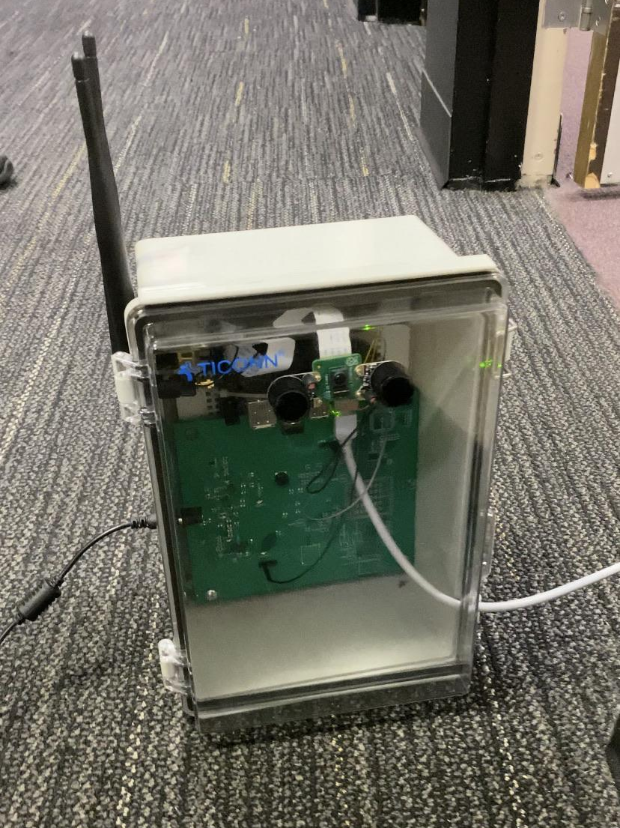
Device Case

Slide 33
Problems/Issues
Unfamiliarity with PCB design and ordering process as well as soldering practices which caused damage to a board as well as a few components due to general inexperience.
The original camera selected for our system was the e-cam cunano which took a long time to implement the connection to the Jetson Nano
The camera was also low resolution though it said resolution was Full HD(1080p) at 60fps

Slide 34
Problems/Issues cont.
Jetson Nano development tools such as pytorch and other prerequisites required several installations as for unknown reasons the Jetson Nano would not read certain prerequisites that were already installed.
Machine Learning algorithm required many compute units to efficiently train the model. This required a great deal of money so we would have a model in a timely manner of which we could test.

Slide 35
Problems/Issues Cont
Our first model lacked background images which caused a large amount of false positives.
Current model required a new database that had to be configured to fit our training model multiple times.
Purchased an off-brand imv219 camera that was nonfunctional with Jetson Nano

Slide 36
Improving in the future
We would look in the future at large battery and solar solutions to allow for a wider range of usage.
We would also like to look at improving the user interface and adding app integration in the future as the website is currently fairly simplistic and bare bones.
A higher quality camera would allow for more accurate detections.

Slide 37
Total Budget
 | Parts For PCB | Soldering Equipment | DroneX Case Parts | Cameras | Jetson | Solar Panel & Battery | ML | Misc. | Grand Total
 | $9.62 | $3.67 | $42.79 | $114 | $149 | $35 | $100 | $4.09
 | $10.69 | $42.11 | $3 | $155 | $20 | $30 | $250
 | $40.79 | $8 | $22 | $20 | $8
 | $28.99
 | $163
 | $180
 | $40
 | $255
Totals: | $728.09 | $53.78 | $67.79 | $289 | $177 | $65 | $350 | $4.09 | $1734.75

Slide 38
Budget to replicate this System
 | Parts For PCB | DroneX Case Parts | Camera | Jetson | ML | Grand Total
 | $9.62 | $42.79 | $20 | $149 | $100
 | $10.69 | $3 |  | $20 | $250
 | $40.79 | $22 |  | $8
 | $28.99
 | $163
 | $180
 | $40
 | $255
Totals: | $728.09/ 4 approx. = $180 | $67.79 | $289 | $177 | $350 | $1063.79

Slide 39
Work Distribution
P: Primary
S: Secondary
Members | Youssef | Harrison | Nick | Stephan
Frontend Software | P | S | S
Backend Software | P | S | S
Machine Learning | P
Soldering |  | S | P | S
Case(Hardware installation and Planning) |  | S | P | S
Documentation | S | P | S | S
PCB Development |  | P | S

Slide 40
Thank You

